Slide 1
Access Network Devices Remotely— Even if the Network is Down— with Out-of-Band Management
Notes:
Ensure Business Continuity with secure out-of-band solutions Deploying a new class of “out-of-band” management appliances that utilize secure cellular connectivity to ensure network uptime.

Slide 2
The Problem:
Remote Access to Globe-Spanning Mission-Critical IT Networks
Network downtime costs $$$
Truck rolls are expensive and time consuming
Network management systems may not work if the network is down
Ensuring business continuity if the network goes down is critical

Slide 3
The Solution: Console Servers
Console servers provide access to failed devices through an Out-Of-Band (OOB) connection for troubleshooting and power cycling.
Serial ports for communication to:
Router
Firewall
Switch
Server
PBX
UPS
PDU
Primary WAN link
for remote administration

Slide 4
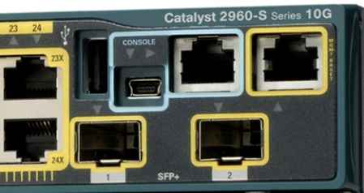
How Console Servers Work
Most IT equipment has a management interface for out-of-band management.
Management is usually through an RS-232 serial console port.
RS-232 port provides direct access to the configuration and management CLI.
Devices include routers, switches, firewalls, load balancers, and IP PBX systems.
RS-232 Console Port
Notes:
Are you prepared for network downtime?
Infrastructure & device management IT and communications equipment vendors facilitate the out-of-band management of their systems, by equipping them with dedicated management interfaces. Networking and communications equipment, such as routers and IP PBX systems, typically provide an RS232 serial console port for direct access to the configuration and management CLI. Many also provide a dedicated management NIC for IP access to a GUI or CLI – in particular managed switches, firewalls and load balancers.

Slide 5
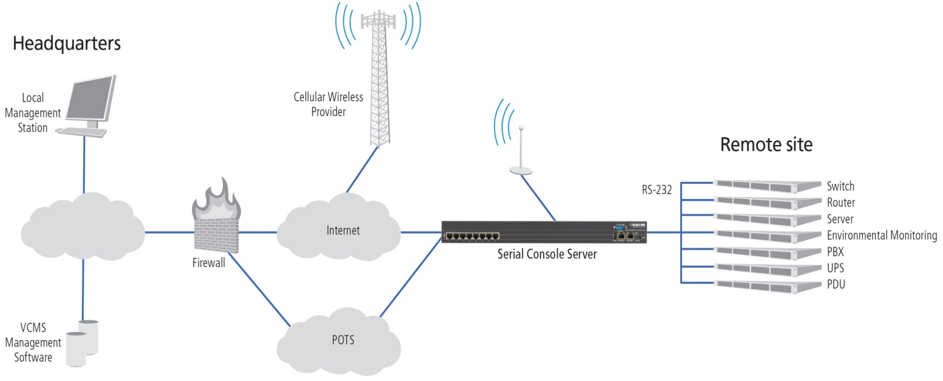
OOB Management
Access remote equipment— even when the network is down.
Three connection options back up each other so you can always reach the console server.

Slide 6
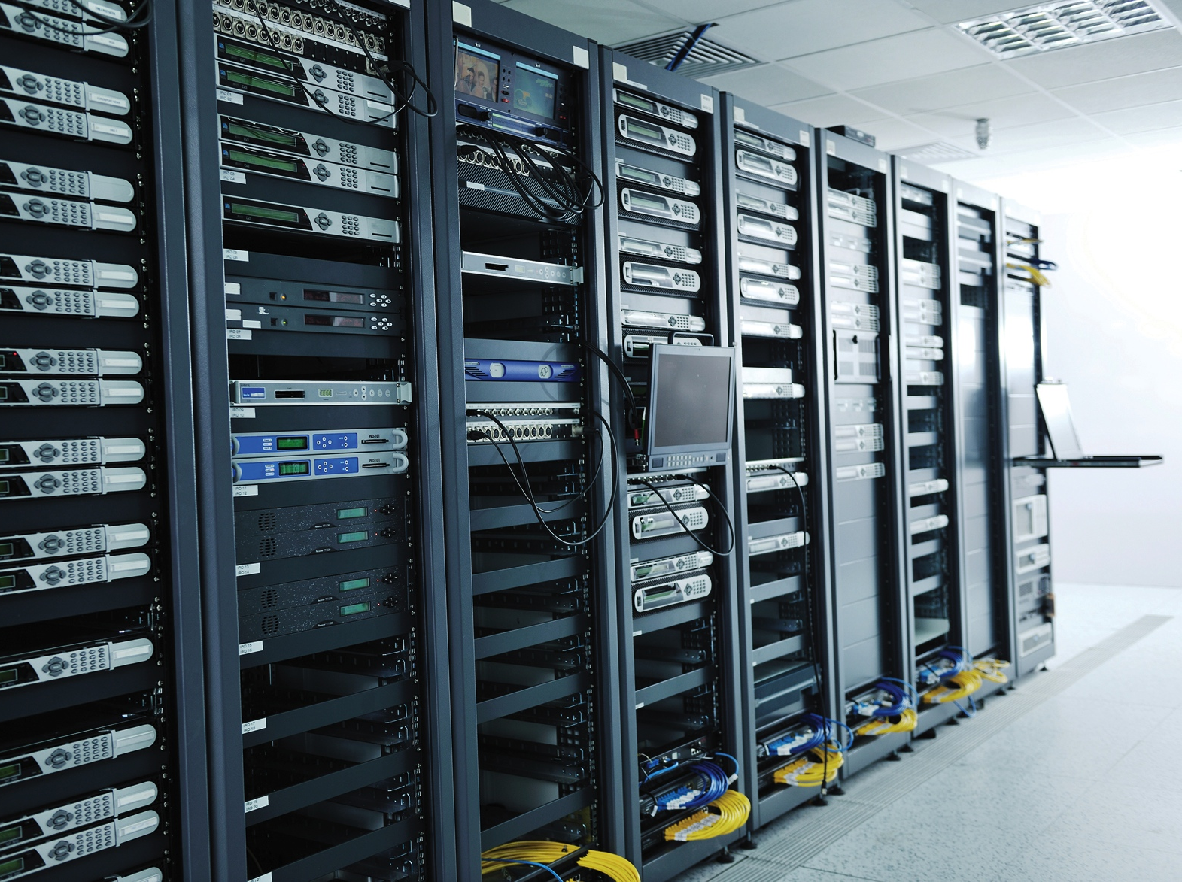
What are the Benefits?
Easy for IT staff to monitor and manage remote network infrastructure
Ensures network uptime
Ensures business continuity
Connection options include:
Cellular
Ethernet/LAN/WAN
Dialup modem

Slide 7
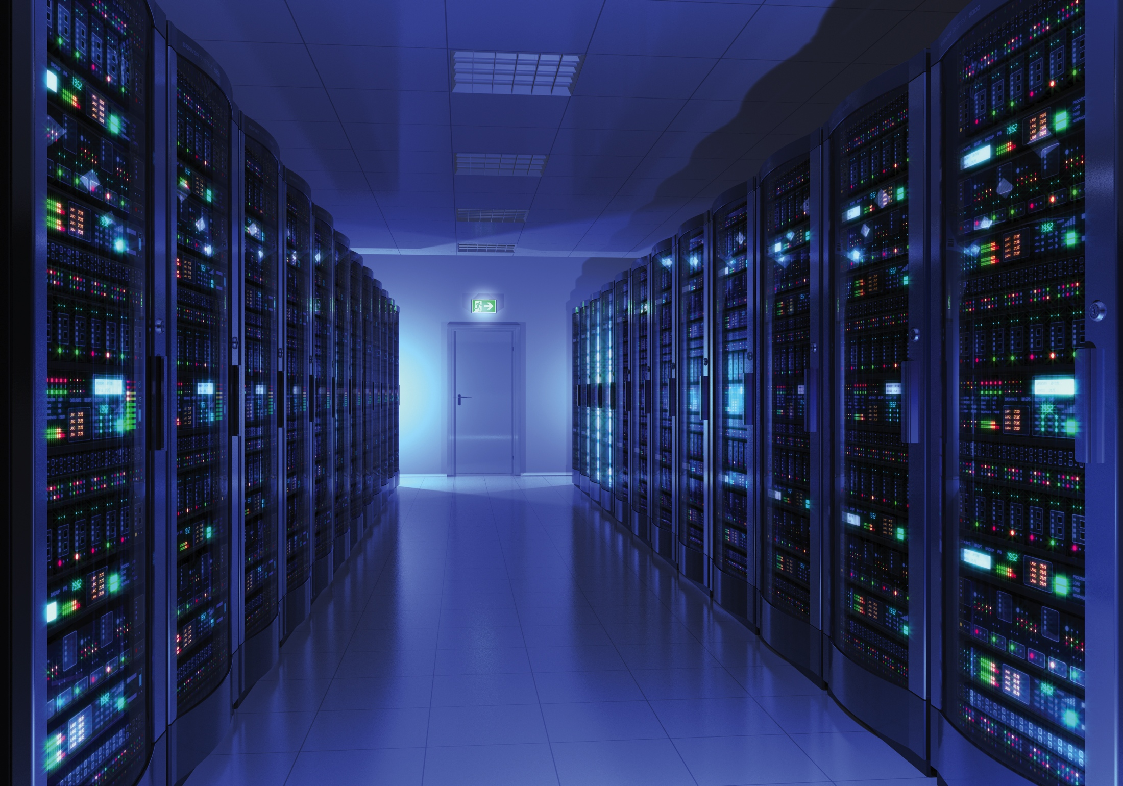
What types of IT systems can benefit from OOB management?
Telephony
Conferencing
Network hardware (routers, switches, firewalls, etc.)
Backup power systems
PDUs
Environmental monitoring
Desktop PCs
Notes:
Are you prepared for network downtime?
Black Box makes it easy for IT staff to remotely monitor and manage their network infrastructure, whether on the road, in an office, or even from home.
From telephony, conferencing and underlying networking hardware, to backup power systems and desktop PCs, the enterprise is reliant on a disparate array of systems from a multitude of vendors. These systems form the backbone of day-to-day operations across various locations, and faults and failures can leave an enterprise hamstrung.

Slide 8
Remote Power Control
Console servers provide connectivity to UPS power systems and intelligent PDU strips.
Usually managed via RS-232 serial, IP network, or USB.
Send alerts when systems switch to backup power.
Send alerts when batteries need to be replaced.
Switch power outlets on/off to re-boot IT assets.
Notes:
Power Monitoring and Control Power monitoring and control is a cornerstone of remote infrastructure management, for notifications when systems have switched over to back up power, notifications when batteries require replacing – and, crucially, enabling remote systems to be powered off and on. To connect to and communicate with this multitude of management interfaces, an out-of-band infrastructure management solution must be geared towards interconnection and interoperability.

Slide 9
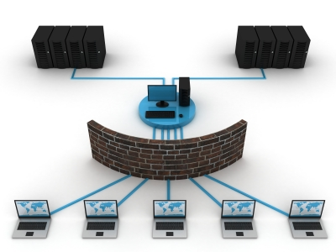
Console Server Security Features
Brokers communications between the management interfaces and the management client.
Provides a single point of access.
Authorizes all access against a core authentication server.
Restrict access by IP address.
IPSec VPNs.
FIPs 140-2 validated.
Notes:
Are you prepared for network downtime?
Enforcing enterprise security policy To address these security concerns and ensure ISO 27001 compliance, an infrastructure management gateway is required to terminate all management interface connections – be they network, serial, or USB – and securely broker all communications between the management interfaces and the management client. This single point of access can then authorize all access against a core authentication server using protocols like TACACS+ and LDAPS, and enforce enterprise policy such as two-factor authentication.

Slide 10
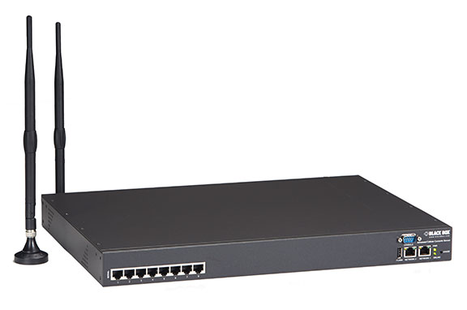
Black Box Console Servers
Integrate with enterprise VPN and authentication systems.
Extend enterprise security policy to distributed assets.
Ensure high availability.
Safeguard business continuity.
Notes:
Are you prepared for network downtime?
Solution Black Box’s unique range of Advanced Console Manager and Infrastructure Manager appliances are purpose built to deliver secure out-of-band management of critical infrastructure across all enterprise locations, and address the requirements for business continuity. Black Box integrates with enterprise data encryption and authentication systems to extend enterprise security policy for secure management of distributed assets, while built-in out-of- band and redundant connectivity options ensure high availability to safeguard business continuity.

Slide 11
Black Box Console Servers
Flexible. Easy to use. Always available.
BBOX Console Servers | LES1200 Series | LES1300/1400 Series | LES1500 Series
Serial Ports | 2,3,4,8,16,32,48 | 8,16,32,48 | 8,16,32,48
Ethernet Ports | 2 | 1 | 2
Embedded Cellular Wireless Modem | – | ✓ | –
Embedded POTS Modem | ✓ | – | –
Secure Authentication | ✓ | ✓ | ✓
Off-line logging | ✓ | ✓ | ✓
GUI Web-based Management | ✓ | ✓ | ✓
Remote Monitoring w/Alerts | ✓ | ✓ | ✓
Notes:
Are you prepared for network downtime?
Flexible, easy to use.
Simple, fast installation
Secure Authentication and offline Logging
Easy remote with browser GUI
User level access, IP filtering
Low Cost, Fast Return on Investment
Always available.
Secure access from anywhere in the world
3G Cellular backup for network failover
Graceful shutdowns of remote UPS systems
Remote monitoring and sophisticated alerts

Slide 12
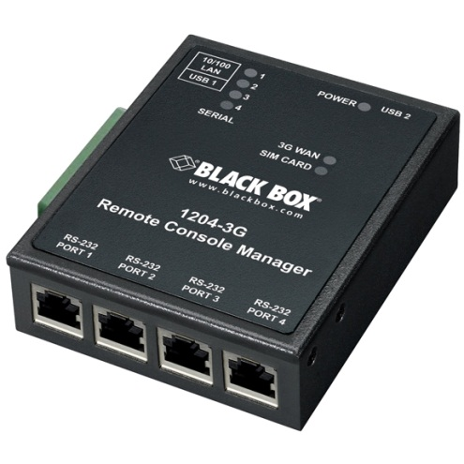
Questions? Need additional information?
Contact one of our Console Server experts today at 888-245-6215
www.blackbox.com/Go/ConsoleServers

Slide 13
The Black Box Difference
Free application engineering
24/7 lifetime technical support
No-hassle 45-day returns
No-questions-asked warranty
888-245-6215 or blackbox.com

