Slide 1
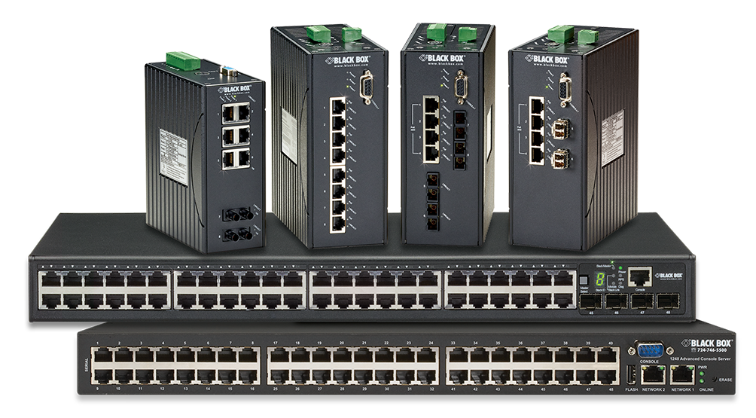
Industrial Ethernet Switches

Slide 2
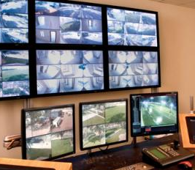
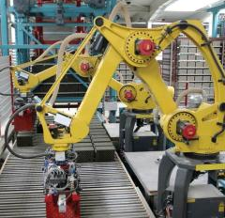
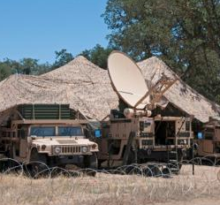
Industrial Ethernet Target Markets/Applications
Security/surveillance providers – Backhaul IP camera video, alarms
Utilities & SCADA/M2M – Automate communications, eliminate truck rolls
Oil/Gas – Control and monitoring of wells and transmission lines
HVAC – Remote control and monitoring of building HVAC systems
Municipalities – Control and monitoring for water/waste water and public safety
Defense – Secure communications in harsh environments

Slide 3
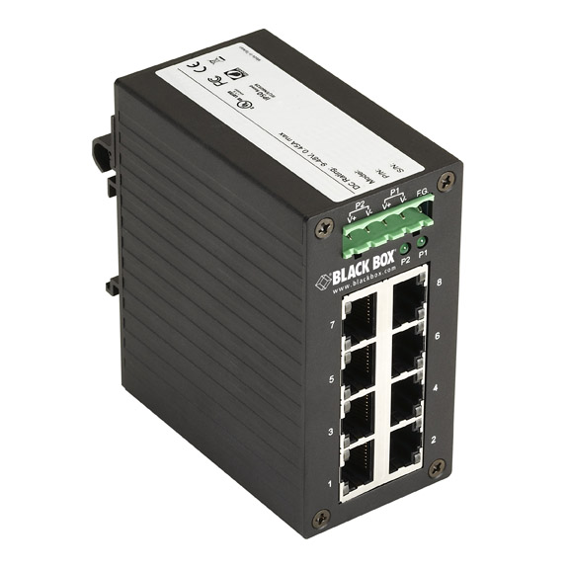
Commercial vs. Industrial Switches
Features | Commercial | Industrial
Mounting Options | Rackmount | DIN rail, panel
Environment | Data center | Harsh environment
Operating Temp. | Normal | Extended
Cooling | Fan cooling with vents/holes | Convection cooling with limited Ingress points
Power | AC power | DC input for safety inside the panel
Packaging | Commercial packaging | Designed to withstand high shock and vibrations

Slide 4
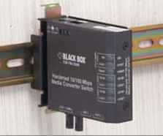
Industrial Switch Overview
Managed, unmanaged
10/100 and 10/10/1000 speeds
Standard and PoE models
Standard, extended, extreme operating temperature ranges
Choice of SFP, short/long reach optics
Choice of power, AC/DC
Speed | Type | Unmanaged |  | Managed
 |  | Copper ports | FO uplinks | Copper ports | FO uplinks
10/100 | Standard | 2-8 | 1-2 | 6-24 | 1-12
10/100 | PoE/PoE+ | 4-6 | 1-2 | 4-8 | 2-4
10/100/1000 | Standard | 2-8 | 1 | 4-28 | 4-28
10/100/1000 | PoE/PoE+ | 4-8 | 1 | 4-8 | 2-4

Slide 5
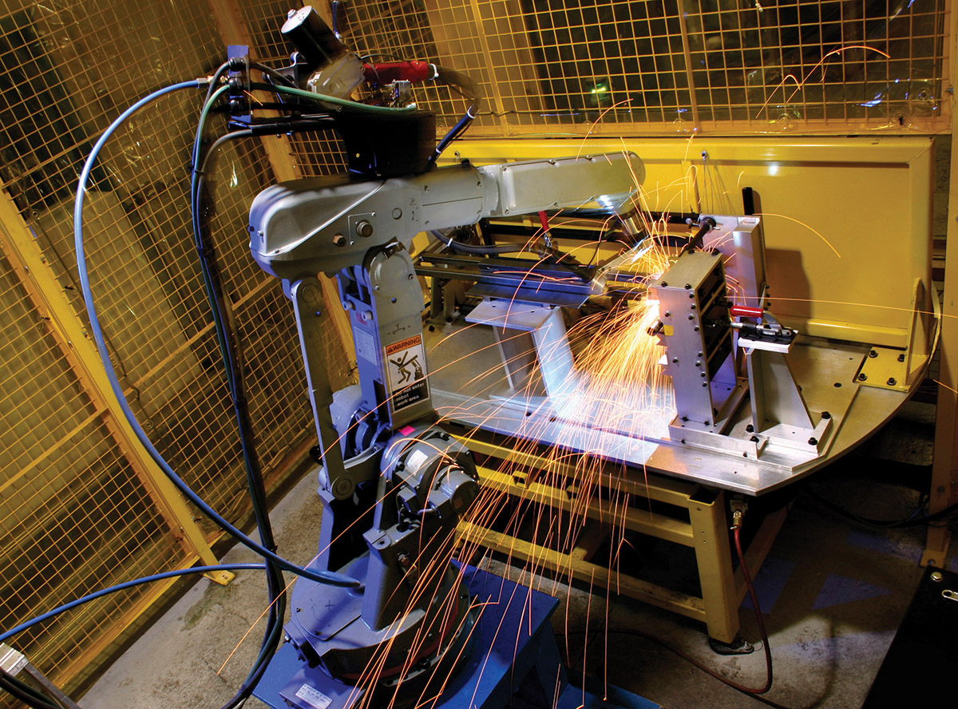
Advantages of Hardened, Managed Switches
Enable remote monitoring and eliminate truck rolls
Provide network redundancy
Spanning Tree protocol
Link aggregation
Alpha-ring protocol
IP multicast
Support for IGMP snooping
Reduces LAN traffic
Better network security
802.1x port-based NAC, user roles

Slide 6
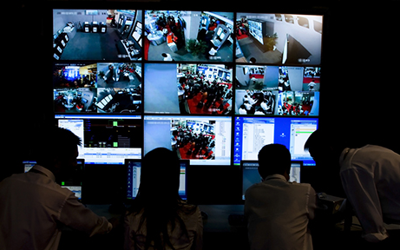
Network Management Methods
Console port access via RS-232 cable (Command Line Interface)
Telnet remote access
SNMP agent
Web browser
TFTP software- upgrade capability

Slide 7
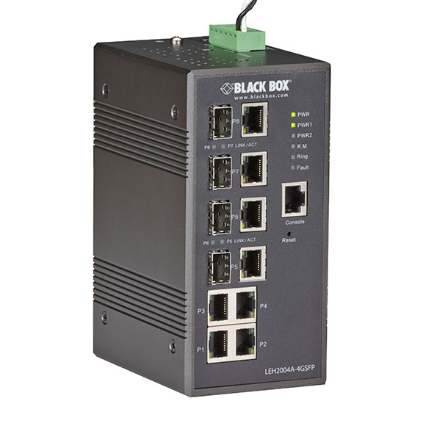
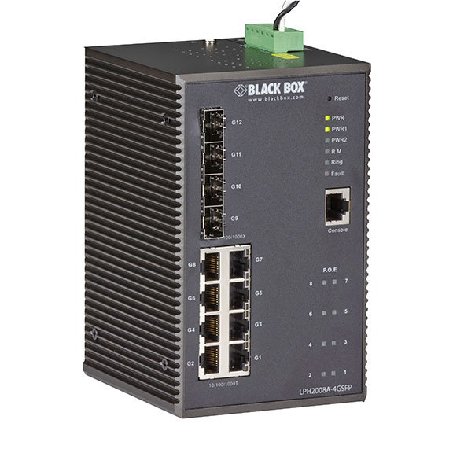
New — LEH2000 Series Gigabit Industrial Ethernet Managed Switches
LEH2004A-4GSFP
LPH2004A-2GSFP
LPH2008A-4GSFP
10/100/1000-Mbps ports
100/1000-Mbps SFP uplinks
LPH switches support PoE+
Redundant DC power
Extended operating temp: 40 to +75º C
DIN-rail mounted
LEH2004A-4GSFP
LPH2008A-4GSFP
with PoE+
Notes:
7
Managed switches support high availability features such as spanning tree, redundant ring topologies, link aggregation, IP multicast.
Managed switches can be configured and monitored remotely via web or SNMP interfaces.
Support for precision time protocol client
Relay output for fault event alarming

Slide 8
LEH2000 Series Key Features/Benefits
High availability
Support for fast failover protocols
Resilient rings, STP, LACP
Remote management
Remote status, configuration, performance monitoring
Web, SNMP, RMON
Scalability
GE access and uplink ports
Flexibility
Support for PoE/PoE+
Eliminates AC wiring for faster deployments
LEH2004A-4GSFP
LPH2008A-4GSFP
with PoE+

Slide 9
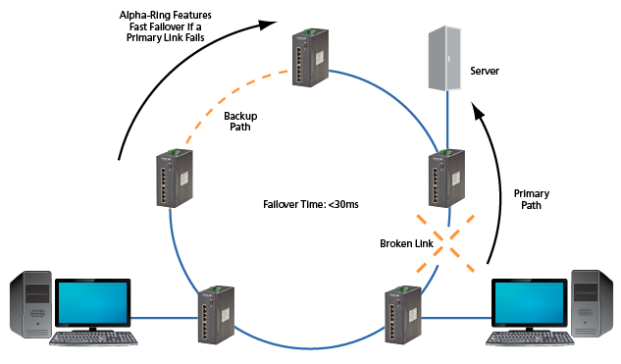
Resilient Ring Operation
Define/enable ring ports on switches
Backup path disabled initially
When a link failure is detected back up path is enabled in 15-30 msec
Check out the video
Server
Backup Path
Alpha-Ring features fast failover if a primary link fails
Primary Path
Failover Time: <30ms
Broken Link
http://go.blackbox.com/Video_ hardened-switches-product-overview
Notes:
Here’s how resilient ring failover works. Each switch in the ring is configured by enabling ring failover and by defining the 2 ring ports on the switch. One of the links in the ring is defined as the backup path and the backup path is disabled initially. Each switch monitors its own ring ports status to detect ring failure. When a switch detects a link down state, it will send link change information to the other switches on the ring. So when a link failure occurs the backup path is enabled within 15-30 msec to keep traffic running around the ring.

Slide 10
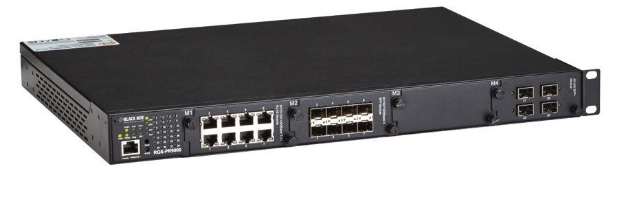
LE2700A Industrial Modular Managed Switch
Modular design enables users to add capacity as demand increases
Choose from copper, fiber, 10/100/1000-Mbps, and 10-GbE interfaces
Rackmount package, extended op temp (-40 to +85º C)
Dual redundant AC/DC power supplies
Low-voltage chassis and power supplies available (LE2700LV, LE2700LV-PS), 20-72VDC
EN 61850-3:2002 certification for EMC, climatic, and mechanical conditions
Supports Web, SNMP, and console user interfaces
Supports high-availability protocols, including STP, link aggregation, and redundant ring protocols
Supports IP multicast snooping with IGMPv2/3
Notes:
New low voltage power supply available for LE2700 series.
LE2700LV is the chassis with dual low voltage supplies included, 20-72VDC.
Spare low voltage power supply is the LE2700LV-PS.
Obtained EN 61850-3 certification for the LE2700 chassis. Certification testing performed for EMC, climatic, and mechanical conditions.
EN 61850-3 is an IEC standard for electrical substation automation.
Complies with IEEE 802.3az energy efficient standards
Field upgradable

Slide 11
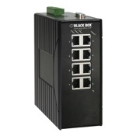
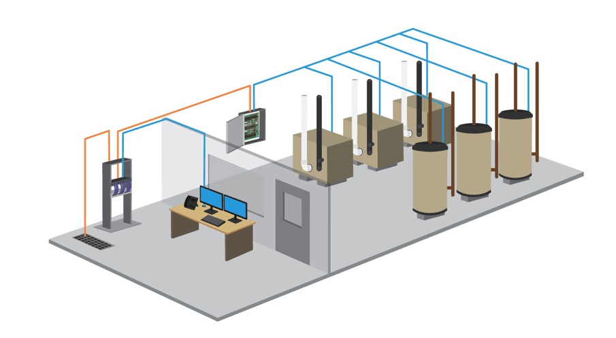
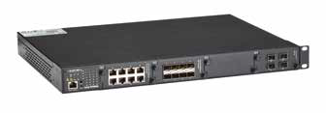
Building Automation Example
LEH906A-2SFP
LE2700A
Hardened switches enable remote monitoring and control of HVAC equipment reducing OPEX and improving system uptime
LEH900 series provide access links to boilers, air conditioning
LE2700 series supports 10/100/1000 copper links for local aggregation and 10-GbE for high-speed uplinks
Notes:
Use LE2700 as aggregation switch

Slide 12
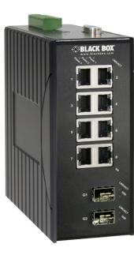
LEH900/1000/1100/1200 Series Fast Ethernet Industrial Managed Switches
(6 -16) 10/100BASE-TX ports
(2) 100BASE-FX fiber ports or (2) 1000-Mbps SFP uplinks
Redundant DC power
Extended operating temp: 40 to +75º C
DIN-rail Mounted
Fully managed
Support for high availability protocols and redundant rings
LEH1200 series are certified for use in Class1/Division2 hazardous environments (oil/gas)
Series | Features
LEH900 | Standard
LEH1000 | PoE
LEH1100 | PoE+
LEH1200 | Class 1, Div. 2
Notes:
12
Managed switches support high availability features such as spanning tree, redundant ring topologies, link aggregation, IP multicast.
Managed switches can be configured and monitored remotely via web or SNMP interfaces.
Road

Slide 13
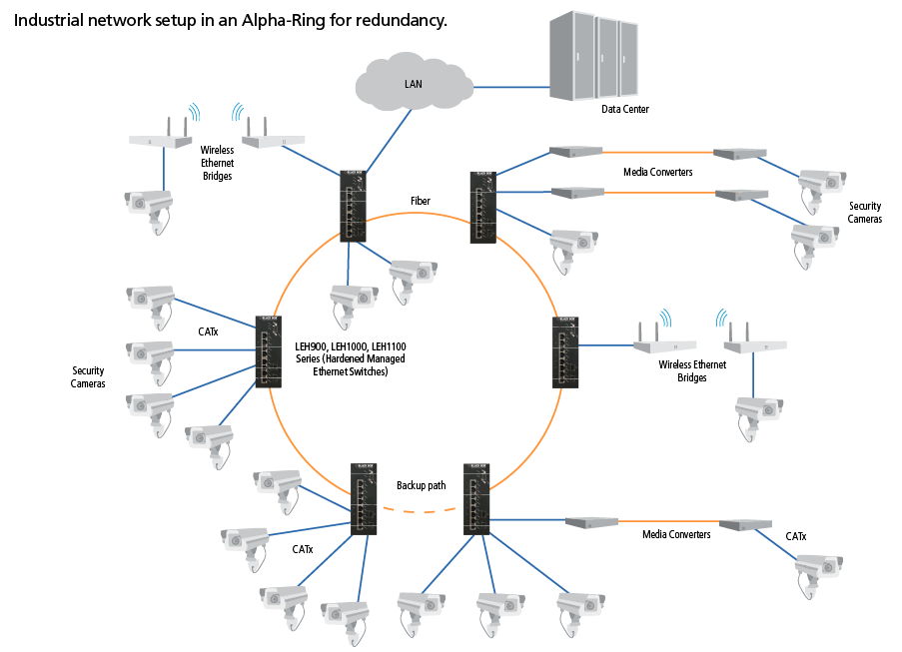
Networking Example — Surveillance
Industrial network setup in an Alpha-Ring for redundancy.
LAN
Data Center
Wireless Ethernet Bridges
Media Converters
Fiber
Security Cameras
CATx
LEH900, LEH1000, LEH1100 Series (Hardened Managed Ethernet Switches)
Security Cameras
Wireless Ethernet Bridges
Backup path
CATx
Media Converters
CATx
Notes:
Use LE2700 as aggregation switch
NOTE: PICK UP DIAGRAM NETWORKING DMP P. 19

Slide 14
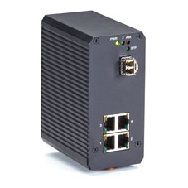
Industrial Ethernet Unmanaged Gigabit Switches
Standard and PoE+ models
Extended temp range: -20 to +70º C
IP31 metal enclosure for use in harsh indoor environments, DIN rail mount
Dual DC power inputs
SFP port enables single-mode or multimode Gigabit fiber uplinks
LGH1004A
Part Number | Description | PoE
LGH008A | 8p 10/100/1000 RJ45
LPH008A | 8p 10/100/1000 RJ45 | PoE+
LGH1004A | 4p 10/100/1000 RJ45 plus 1p GE SFP
LPH1004A | 4p 10/100/1000 RJ45 plus 1p GE SFP | PoE+
LPH1006A | 4p 10/100/1000 RJ45 plus 2p GE SFP | PoE+
LPH1004A (PoE+)

Slide 15
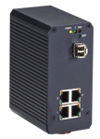
IP Security Camera Backhaul via PoE Switches
Internet
Remote Clients
Local Clients
Router
LAN
Network Video Recorder
PoE Switch
Analytics Software
IP PoE Cameras
Notes:
Here is a security surveillance example using PoE switches with IP cameras.
In this example the remote cameras are powered from the LPH1004A PoE switch. This is an Industrial Ethernet gigabit switch that is designed for harsh environments with extended temperature range.
The LPH01004 gathers camera traffic and has a fiber uplink to backhaul the video long distances to the aggregation switch or command center where data is stored or analyzed by security personnel.
Another popular application for PoE switches and media converters is to backhaul data from wifi access points.
The value of PoE is that it allows installers to complete the project more quickly and at lower cost by avoiding the cost and time associated with installing AC power circuits in remote locations. PoE switches and converters not only transport the data but deliver power to IP cameras and wifi access point, too.

Slide 16
Resources
Industrial Ethernet Switches
www.blackbox.com/Store/Results.aspx/Networking/Industrial/n-4294956767
Blog: 5 Ways Industrial Switches are Different
http://blog.blackbox.com/technology/2011/10/5-ways-industrial-devices-are-different/
White paper: Ethernet in Harsh Environments
http://go.blackbox.com/forms/Fluke-EnetHarsh-Whitepaper
Videos:
Industrial Ethernet Switches
http://go.blackbox.com/Video_ hardened-switches-product-overview
Industrial Switch Demo
http://go.blackbox.com/Video_ hardened-switches-product-demo

Slide 17
The Black Box Difference
Free application engineering
24/7 lifetime technical support
No-hassle 45-day returns
No-questions-asked warranty
724-746-5500 or blackbox.com

