Slide 1
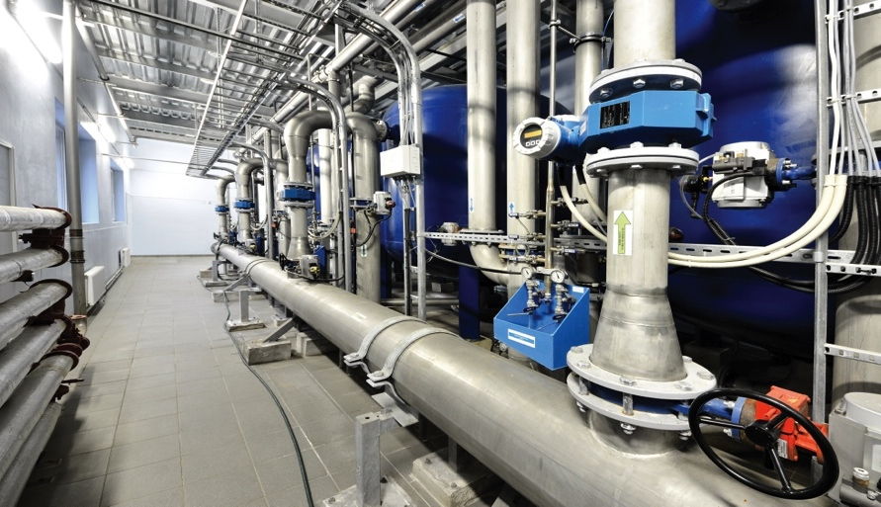
High Availability for Industrial Ethernet Networks

Slide 2
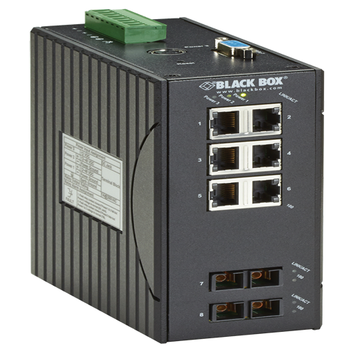
Commercial vs Hardened Switches
Features | Commercial | Hardened
Mounting Options | Rackmount | DIN rail
Environment | Data center | Harsh environment
Operating Temp. | Normal | Extended: -40° to +75°C
Cooling | Fan cooling with vents/holes | Convection cooling with limited ingress points
Power | AC input | DC input
Design | Commercial packaging | Designed to withstand shock, vibrations, dust, and water

Slide 3
Industrial Certifications
ISA 12.12.01 for Class 1, Division 2 hazardous locations
NEMA TS1/TS2 for traffic control
EN61000-6-2 and EN61000-6-4 Generic Standard Immunity for industrial environments
UL® 508 Industrial Control Equipment
ITS rated

Slide 4
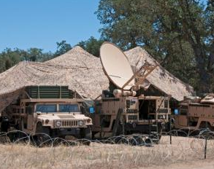
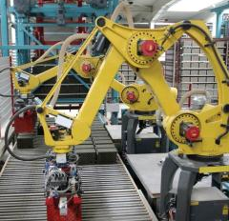
Industries/Applications for Industrial Networking
Building automation
Chemical plants
Defense/military
Factory automation
Mining
Oil/gas drilling
Security/surveillance

Slide 5
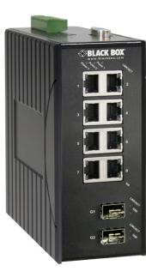
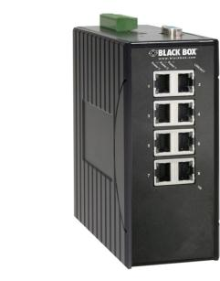
LEH Series Hardened Managed Ethernet Switches
All copper and copper/fiber switches.
PoE/PoE+ options.
Class 1, Div. 2 options.
Hardened to -40 to +75°C.
IP30-rated enclosures.
DC powered.
DIN-rail mounted.
Series | Features
LEH900 | Hardened
LEH1000 | Hardened with PoE
LEH1100 | Hardened with PoE+
LEH1200 | Hardened Class 1, Div. 2
Notes:
5

Slide 6
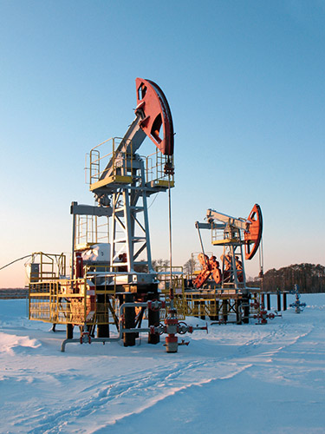
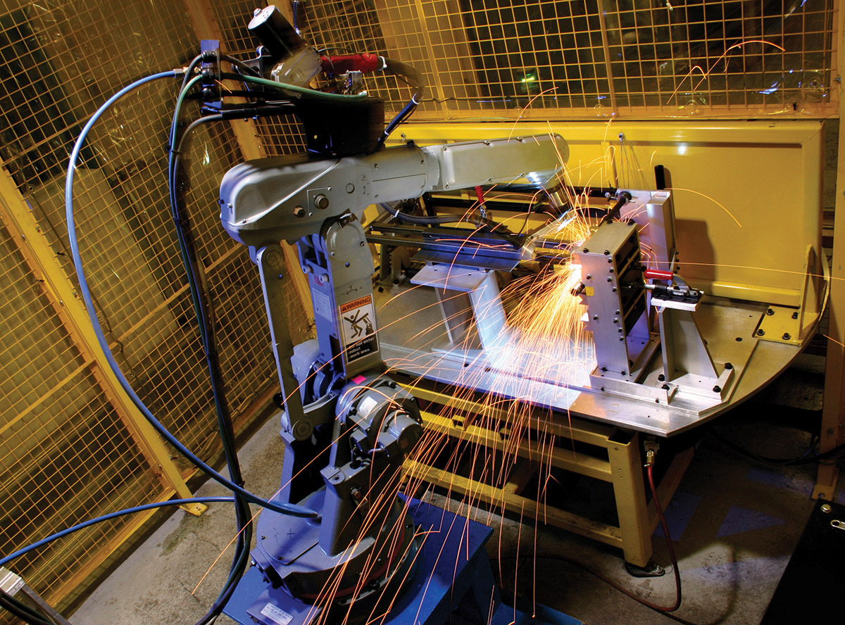
Advantages of Hardened, Managed Switches
Enable remote monitoring and eliminate truck rolls
Provide network redundancy
Spanning Tree Protocol
Link Aggregation
Alpha-Ring Protocol
IP multicast
Support for IGMP snooping
Reduces LAN traffic
Better network security
802.1x port-based NAC, user roles

Slide 7
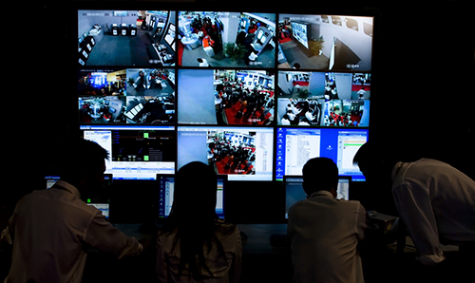
Network Management Methods
Console port access via RS-232 cable (Command Line Interface)
Telnet remote access
SNMP agent
Web browser
TFTP software- upgrade capability

Slide 8
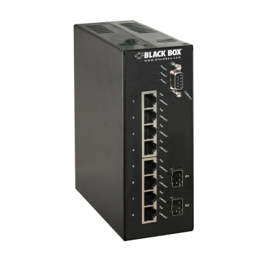
α-Ring (Alpha-Ring) Protocol
Faster network recovery than STP
Only 15-30msec hitless failover
Proprietary protocol.
The last physical connection made in the ring is selected as the backup path.
Back up Path

Slide 9
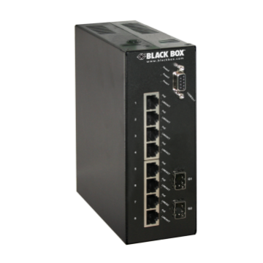
How does an α-Ring work? (1)
Data from edge devices connected to different switches travel within the ring.
Back up Path
α-Ring < 30ms
Notes:
[T] The data from different switches can be transmitted and trafficked within the same ring network.

Slide 10
How does an α-Ring work? (2)
During a link failure, system fails over to the backup path in < 30 ms.
Back up Path
α-Ring < 30ms
Transmit “Link change” information
Link
down
Transmit “Link change” information
Notes:
[T] The ring maintenance is conducted by each attached switch. When any of the connections is broken, the switches at each end will be notified and send the “Link Change” signal to all the other attached switches in the network. And the backup path will automatically pick up the connection in 15 milliseconds without paralyzing the network data transmission.

Slide 11
Spanning Tree vs. α-Ring
STP advantages
STP preferred if IGMP snooping involved.
STP allows definition of path while Alpha-Ring does not.
Standardized, interoperability among vendors.
Alpha-Ring advantages
Faster failover than STP (30 msec vs. 85+ msec).
More flexible topology, no need to define hierarchy.
Easier to set up.
Consumes less data plane bandwidth by not continuously sending test packets.

Slide 12
Why Black Box?
Technical Support
24/7 FREE, live Tech Support
In 60 seconds or less
Quality Reputation
No problems, No hassles.
We make it RIGHT.
Industry’s Best Warranties
No-questions-asked protection, even from accidental drops or spills.
One Year to LIFETIME
45 Day Return / No Restocking Fee

