Slide 1
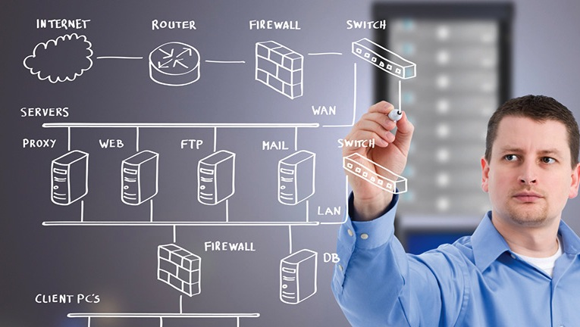
Three Solutions for LAN Extension

Slide 2
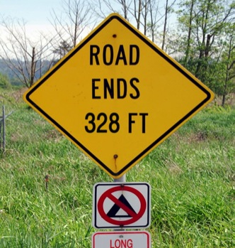
Ethernet Distance/Range
Ethernet over copper twisted-pair wiring has a distance limitation of 100 m (328 ft.)
Speed | Distance | Cable | Connectors | IEEE Standard
10 Mbps | 100 meters | CAT3 or better | RJ-45 | 10BASE-T 802.3i
100 Mbps | 100 meters | CAT5 or better | RJ-45 | 100BASE-TX 802.3u
1 Gbps | 100 meters | CAT5 or better | RJ-45 | 1000BASE-T 802.3ab
10 Gbps | 100 meters | CAT6a or better | RJ-45 | 10GBASE-T 802.3an-2006

Slide 3
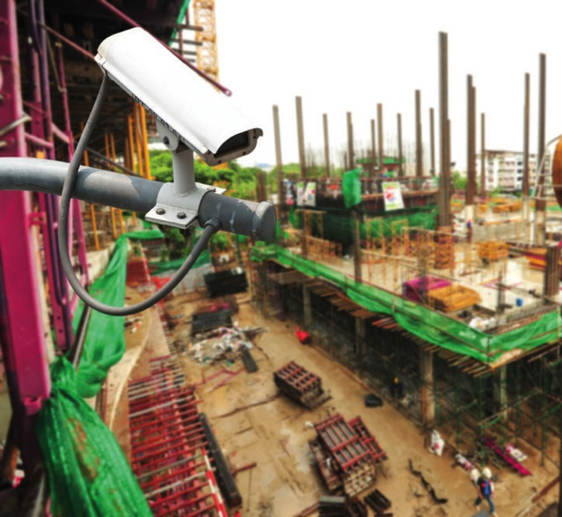
LAN Extension Application Examples
Applications that may require more than the 100 meter Ethernet distance.
Wiring closet to data center
Workstations that are more than 100 m from wiring closet
Building to building on campus
Connecting to remote Wi-Fi access points
Connecting to remote security cameras

Slide 4
Three Solutions for LAN Extension
Technology | Best Performance | Use Existing Copper Facilities | Most Versatile
Media Converters | • | — | —
Ethernet Extenders | — | • | —
Wireless Extenders | — | — | •
Media Converters – convert Ethernet links from copper to fiber
Ethernet Extenders – extend Ethernet over UTP or coax wiring
Wireless Extenders – extend Ethernet using radios

Slide 5
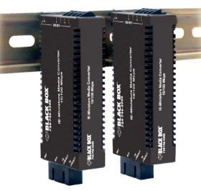
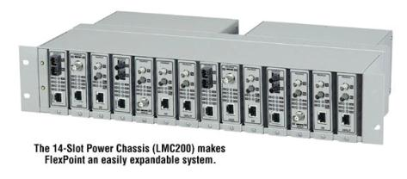
Media Converters
Convert copper links to fiber links for extended reach
10-Mbps to 10-Gbps speeds supported; short and long range optics; SFPs
Standard (office) and hardened (industrial/harsh environments) models
Standalone and chassis systems
Managed and unmanaged
Markets: government, industrial automation, power/utility, intelligent transportation

Slide 6
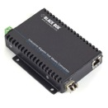
Media Converter Example
IP Security Camera Backhaul
LGB5124A
SFP Switch
Data Center, Internet, or Security HQ
PoE Media Converters
LGC5300A
IP Security Cameras

Slide 7
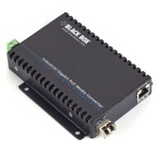
Media Converter Use Cases
3rd Party Switch
UTP
Fiber
UTP
Workstation
Media Converter
Media Converter
Fiber
UTP
3rd Party Fiber Switch
Media Converter
3rd Party Camera
Multimode Fiber
Multimode Fiber
Single-mode Fiber 5 km
3rd Party Fiber Switch
3rd Party Fiber Switch
Media Converter
Media Converter

Slide 8
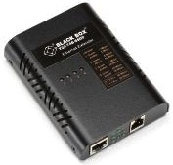
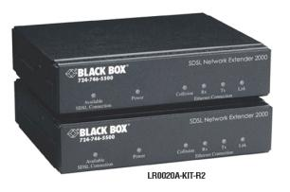
Copper Ethernet Extenders
Extend Ethernet beyond 100 meters over copper cable
Re-use existing copper wiring facilities for IP applications
Support for CATx twisted pair and coax cable
PoE support
Markets: enterprise, mining, industrial automation, power/utility
Typical application — extend Ethernet to a remote building, garage, or guard shack
Media | Ethernet Speed | Protocol | Max Distance | Max Speed
CATx cable | 10/100 | G.SHDSL | 6800 m @ 192 kbps | 5.7 Mbps @ 2100 m
CATx cable | 10/100 | VDSL | 1900 m @ 1 Mbps | 50 Mbps @ 300 m
CATx cable | 10/100 | VDSL2 | 1219 m @ 28 Mbps | 100 Mbps @ 152 m
75 ohm coax | 10/100 | VDSL2 | 2600 m @ 5 Mbps | 85 Mbps @ 200 m

Slide 9
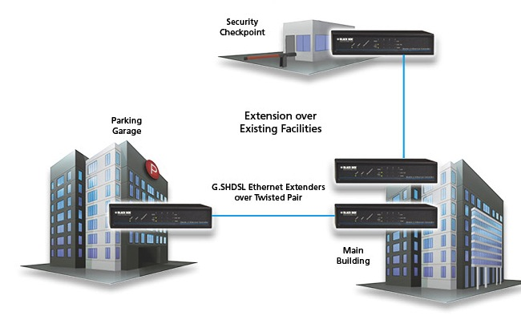
Ethernet Extension Example
Deliver IP services to security checkpoint over existing UTP wiring
Corporate LAN access
Internet access
VoIP phone service
Security camera backhaul
Re-use existing wiring
Reduces installation costs
Speeds project implementation
Avoid trenching new fiber
Security Checkpoint
Parking Garage
Extension over Existing Facilities
G.SHDSL Ethernet Extenders over Twisted Pair
Main Building

Slide 10
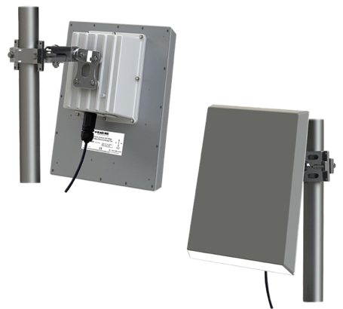
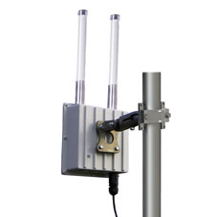
Wireless Extenders
Up to 300-Mbps RF data rate
Bridge and star network topologies supported
Range up to 15 miles for bridge; 5 miles for point-to-multipoint configuration
Data security provided by AES 128-bit encryption
Built-in browser interface for easy reconfiguration and link status monitoring
Rugged, weatherproof, cast-aluminum NEMA enclosures for outdoor use
Notes:
The LWE200 series is a family of products for wireless Ethernet extension.

Slide 11
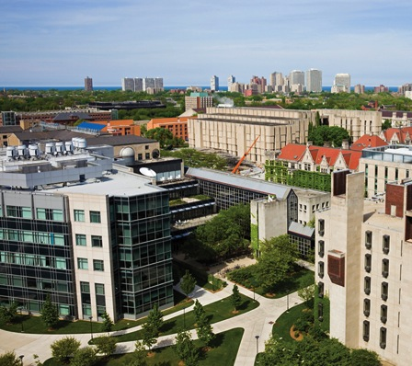
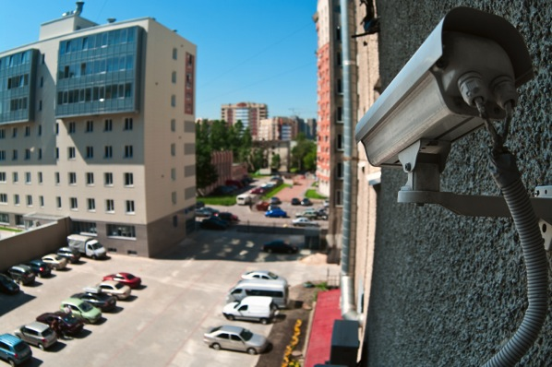
Industry/Applications
Enterprise, Education | Extend network to adjacent buildings without trenching new fiber
Oil/Gas, Utilities | Security/surveillance, backhaul IP security camera feeds, control PTZ SCADA, remote monitoring and control of sensors/process
Hospitality | LAN extension, extend Internet access to remote lodge or digital signage

Slide 12
The Black Box Difference
Free application engineering
24/7 lifetime technical support
No-hassle 45-day returns
No-questions-asked warranty
888-245-6215 or blackbox.com

